Slide 1
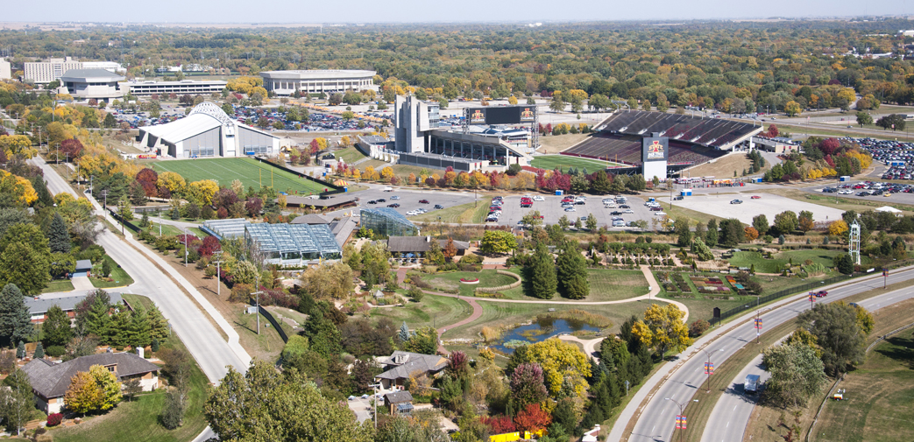
Housing Prices in Ames, Iowa: Advanced Machine Learning Techniques
Notorious B.I.ggplot: Angie Lin, Chris Castano, Kat Kennovin

Slide 2
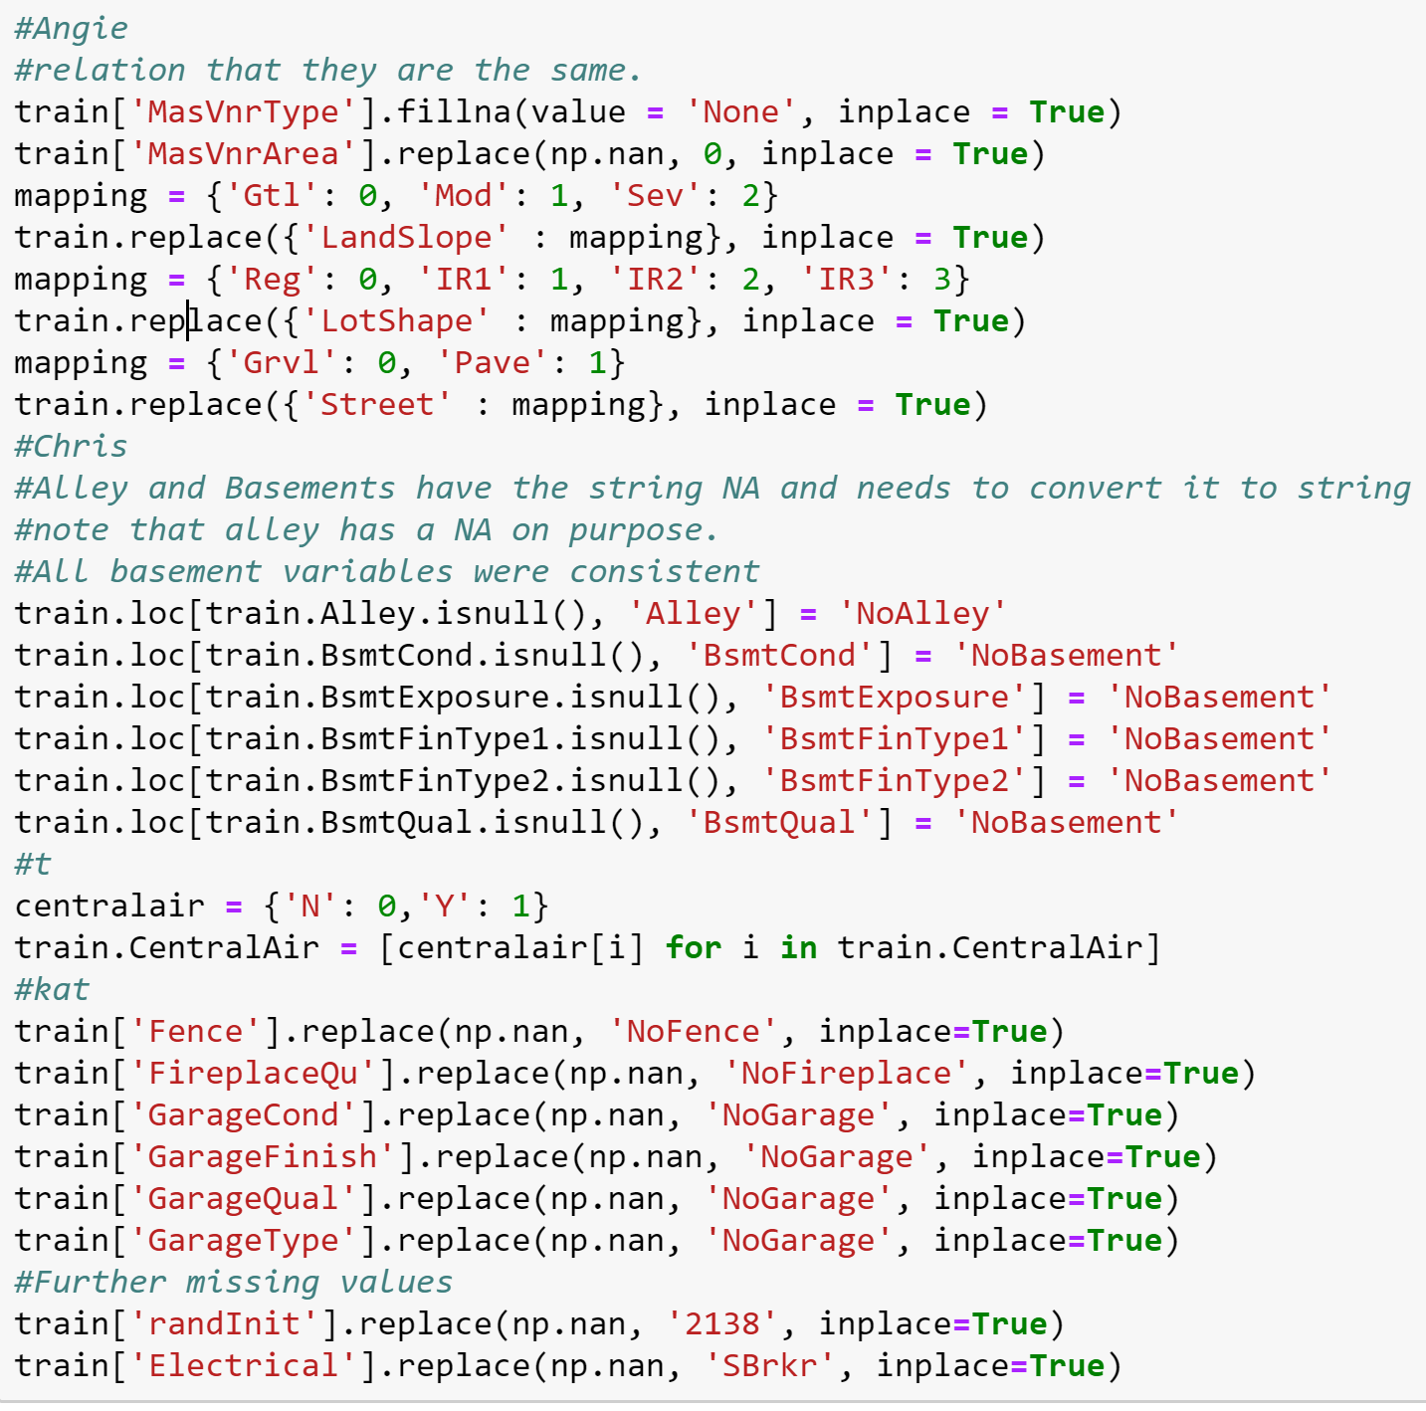
Missingness - Categorical Variables
Many NA’s included in the test data set. Oftentimes meant the absence of the feature denoted by the column. However, Python can read NA strings in a dataframe as null values, so we thought it best to impute different values.
Divided the categorical variables up and were each responsible for analyzing and imputing data.
Turned some categorical variables into binaries.

Slide 3
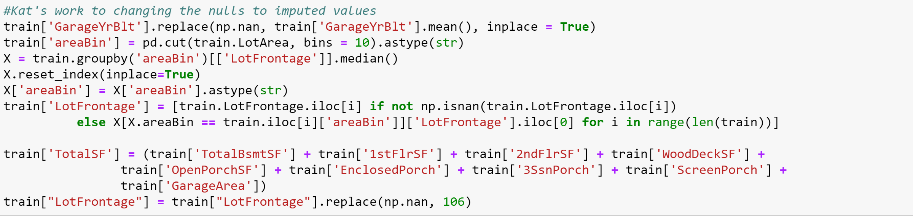
Missingness - Quantitative Variables
Missingness in quantitative variables was dealt with by imputing the mean or median where deemed appropriate.

Slide 4
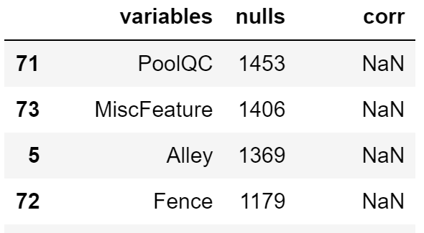
Missingness - The Lost Causes
Two variables had over 1,400 missing values.
While we recognized that they might be missing for reasons other than simple entry error, we felt that imputing our own values might lead to overfitting.
Dropped them from the dataset entirely

Slide 5
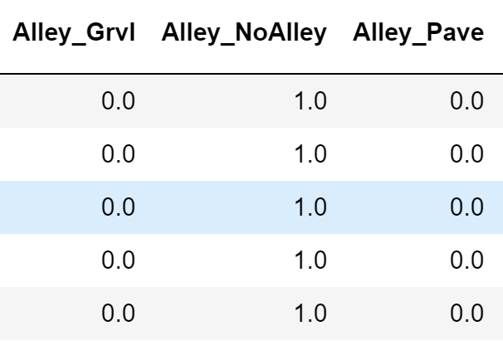
Growing Pains:
Initially thought we might use linear regression
Dummified all categorical variables
Wound up with over 180 variables
Decided on using a tree model
In Friday lecture, Aiko mentioned that dummifying variables in trees is unnecessary and even harmful to the model.
Un-dummified variables and went back to the drawing board

Slide 6
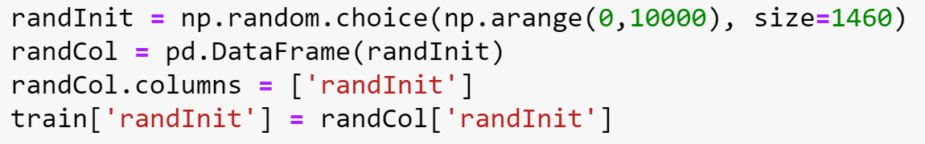
Feature Engineering
Added a column of completely random integers before evaluating feature importance of our random forest model. If a variable performed worse than a variable of randomly selected values, we knew that it did not contribute any predictive power.
Features we added to our data: Total Square Footage, Seasonality, Remodeled, New House, and Total Bathrooms.
Notes:
Should we also add bullet for original features removed after addition of new features?

Slide 7
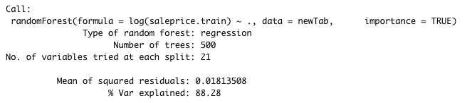
Modeling pt. 1: Random Forest
Ran random forest tests to isolate which categories were the most important variables. Four variables performed worse than random. These variables were discarded from the model.

Slide 8
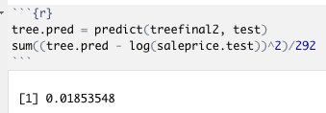
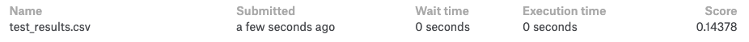
Modeling pt. 1: Random Forest
To test for the best model, the data was split into the training and test set. (80-20 divide). We used the model that gave us the best test dataset error.
We submitted this model onto Kaggle to see the actual test error and we had an RMSE of 0.14378.

Slide 9
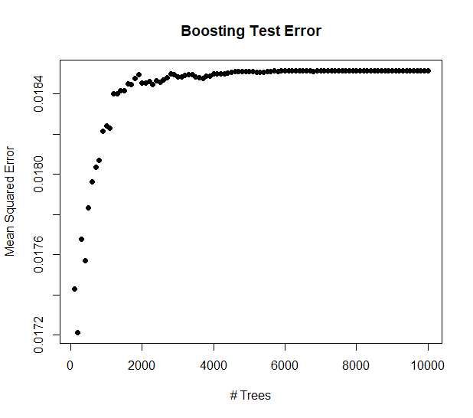
Modeling pt. 2: Boosting
Attempted boosting tree models to try and reduce error even further. Used a plot of MSE vs number of trees to determine which number of trees would give us the best MSE.
Found that while variance decreased with number of trees, error significantly increased.

Slide 10
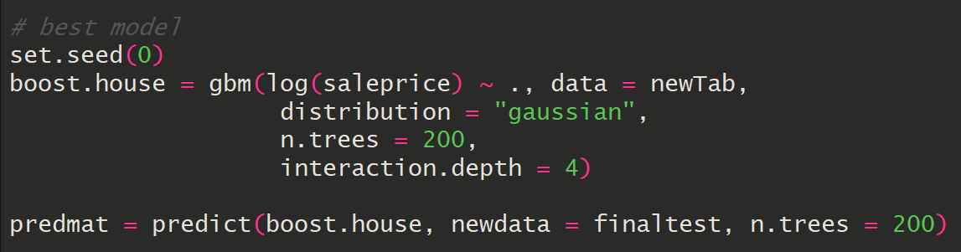
Modeling pt. 3: Boosting Continued
Given our data, and after many different attempts with different features, the optimal number of trees to run in the boosted model was 200.

Slide 11
Results and Future Work
The boosted model gave us the best RMSE of our models.
In the future, we would like to have a stacked model that would likely give us a better result.
Refine other parameters in both models to see if it would perform any better such as interaction depth, minimum number of rows in a node to allow splitting, and minimum number of rows allowed per terminal node.
Conduct analysis in Python instead of R

